Slide 1
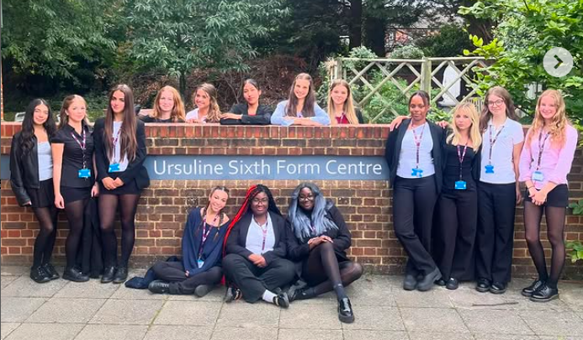
Sixth Form
Year 10 Transition Evening

Slide 2
Ms Alexander
Deputy Headteacher’s Welcome Message

Slide 4
Mr Ryan
Assistant Headteacher

Slide 5
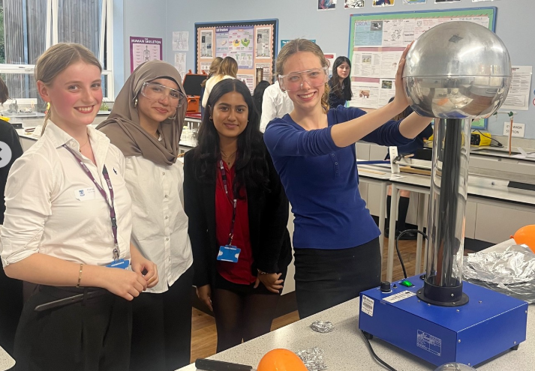
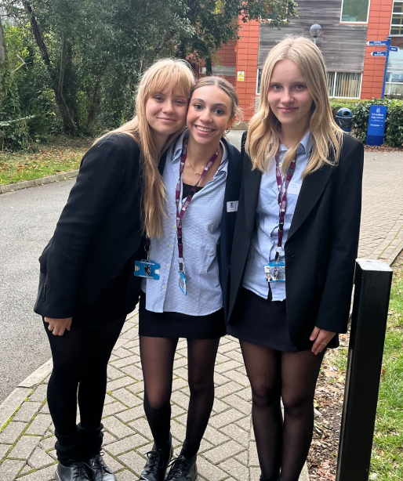
A place where all students can belong and succeed

Slide 6
Key Dates Academic Year 2025/26
4th March | Y10 Sixth Form Transition Parents’ Evening
April 2024 | Speed networking/student assemblies with Y12 students Introduction to 6th form subjects and Q and A sessions
5th May | Internal Applications for Ursuline Sixth Form open on Applicaa
30th June | Year 10 Taster Day for Sixth Form Courses
1st July and 2nd July | Year 10 Interviews with SLT for Sixth Form Courses
W/B 7th July | Offers of a place made to Internal Applicants
September 2025 | Year 11 Information Evening
October 2025 | 6th Form Open Evening
November 1st | Deadline to confirm acceptance of place
January 2026 | Year 11 Parents’ Evening

Slide 7
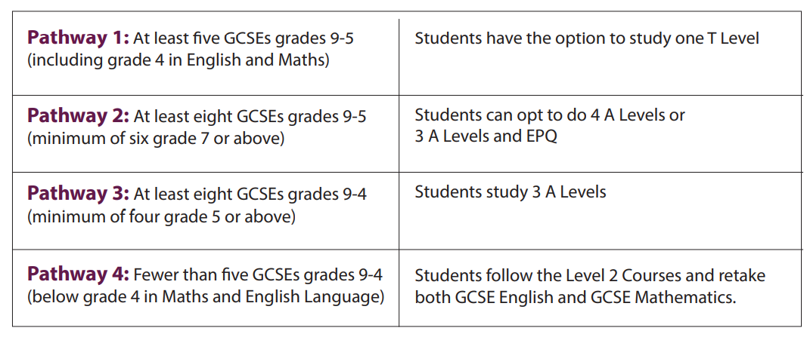
Pathways

Slide 8
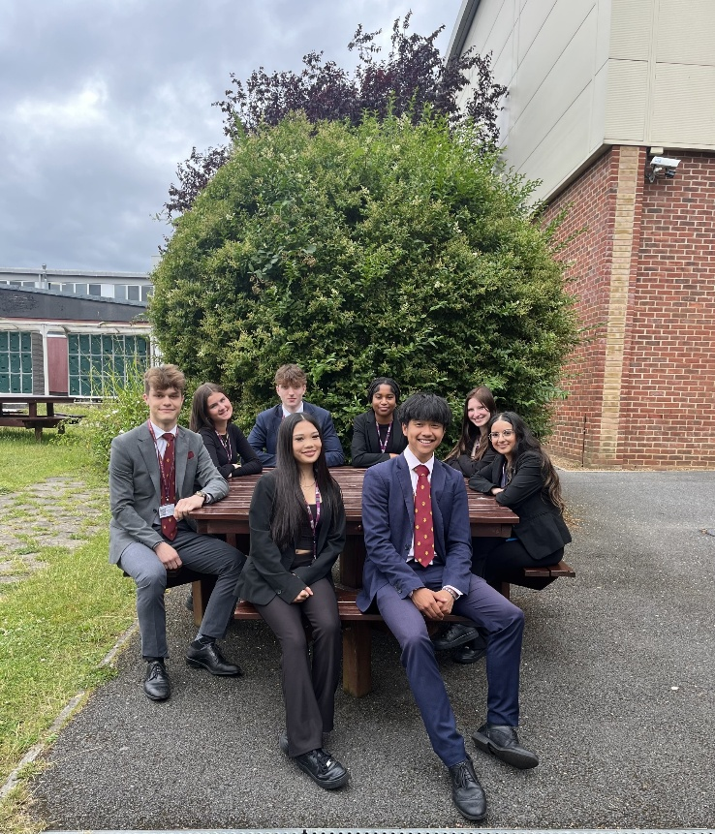
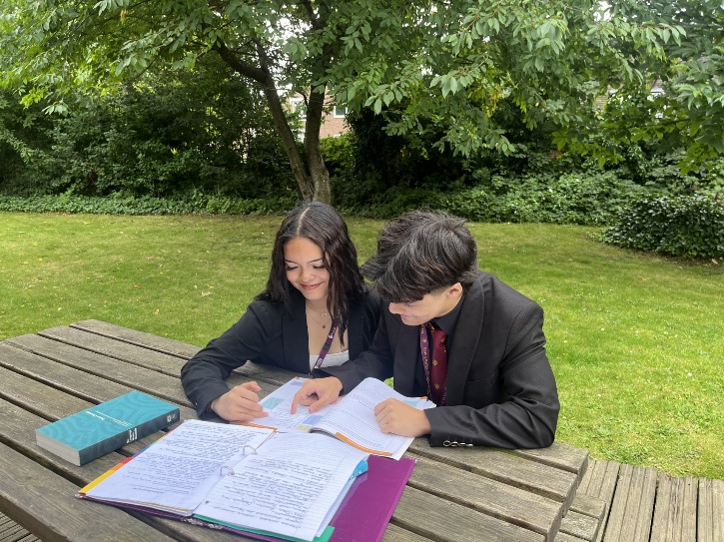
Option Lines and Partnership with WC
As a student at the Ursuline, students have access to courses at Wimbledon College as part of our partnership arrangements. This facilitates a greater choice of subjects as well as different combinations.

Slide 9
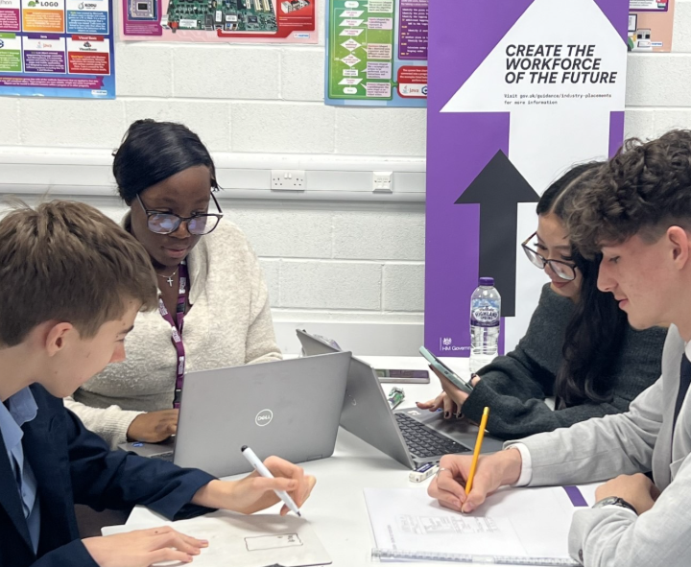
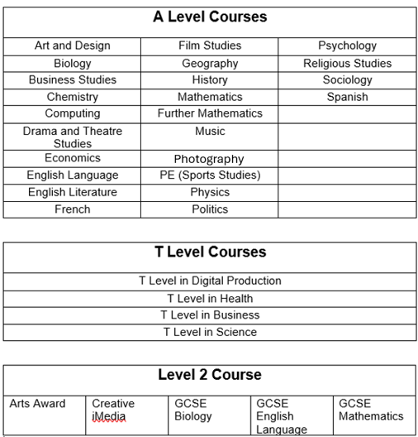
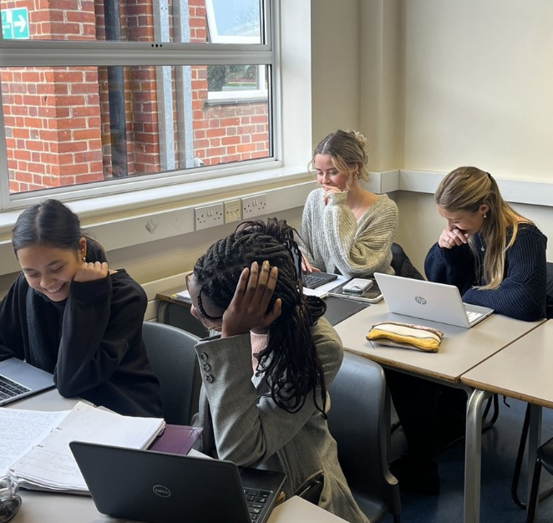

Slide 10
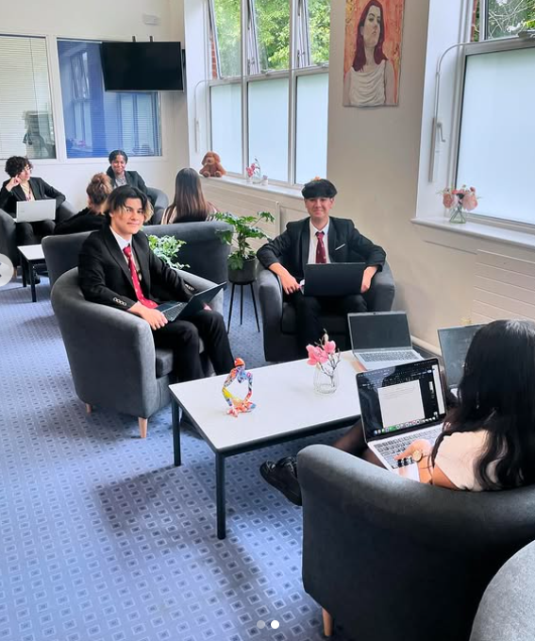
Option Blocks and subjects
We share option blocks with WC, but some courses are just offered at UHS and vice versa.
For example:
computer science, music and PE are just offered at WC
English Language, French and drama are just offered at UHS
The other subjects are offered at both schools.
*We do not anticipate much change, but as in any college or sixth form, courses are subject to change if staffing or demand for courses changes.

Slide 11
Minimum Course Entry Requirements
Students must meet the course entry requirements to be allowed enrol on a course.
When students apply, they are selecting an interest in a course.
No student actually enrols on a course until they have their results on GCSE results days.
Many will change their mind – that’s OK!

Slide 12
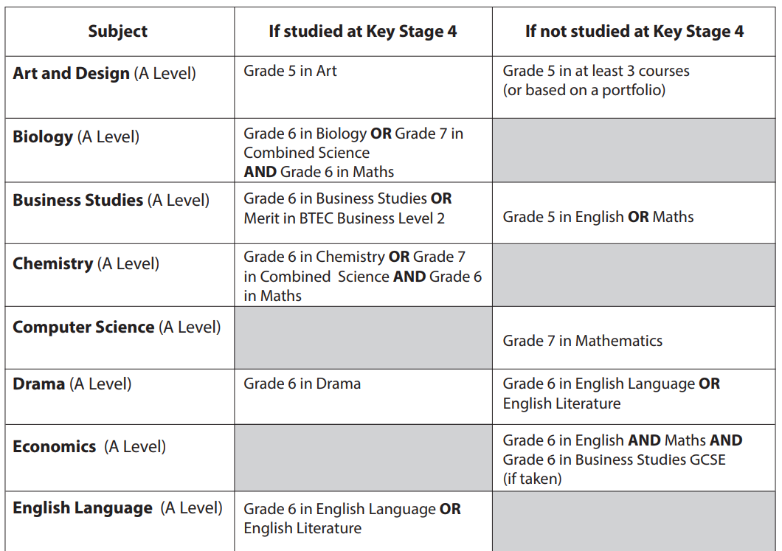
Minimum Course Entry Requirements - A Level Courses

Slide 13
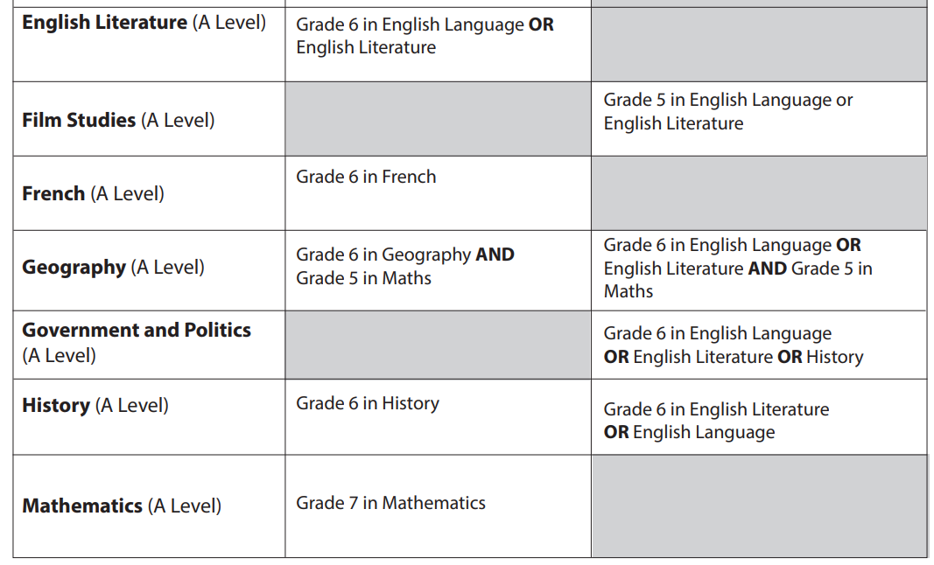
Minimum Course Entry Requirements - A Level Courses

Slide 14
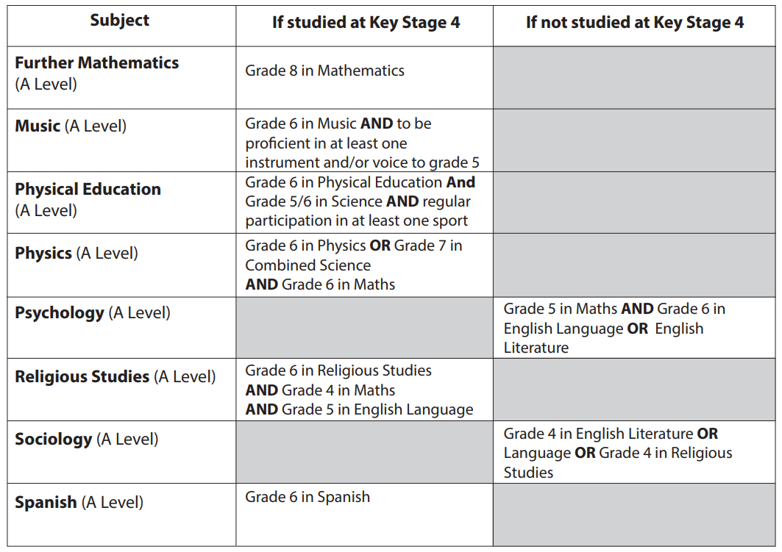
Minimum Course Entry Requirements - A Level Courses

Slide 15
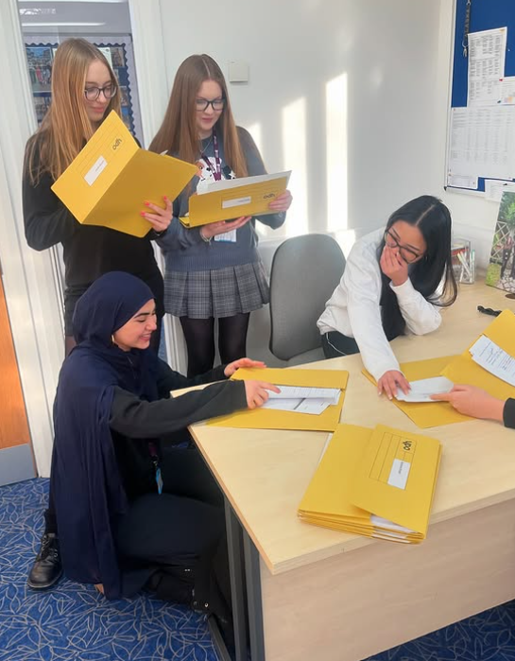
Why do students need to carefully consider their subject selections?
Students need to carefully consider their subject selections at A-level for several reasons:
Specialisation
University Requirements
Career Pathways
Personal Growth
Performance

Slide 16
Application Process - Applicaa
Students complete their application to the Ursuline Sixth Form via Applicaa
A username and account will be set up for all students (5th May)
There are 7 steps to complete on the application form
Students will also have an interview with a member of SLT to discuss their suitability for joining our 6th form and to discuss the courses they are considering studying.
Once the application is complete, it will be reviewed and we will offer places to internal students from the week beginning the 10th July.

Slide 17
Mr Gibson
T Levels

Slide 18
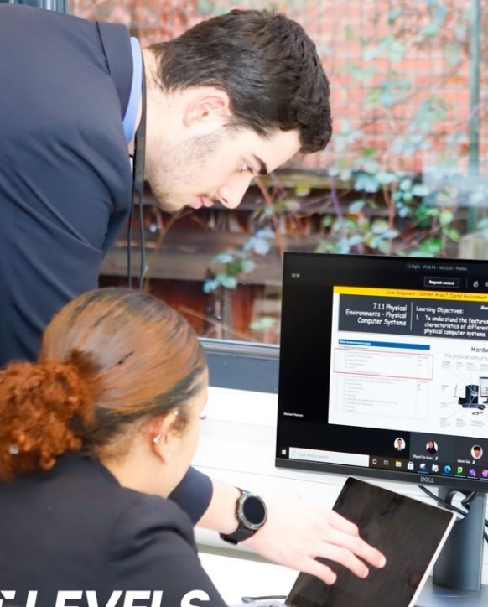
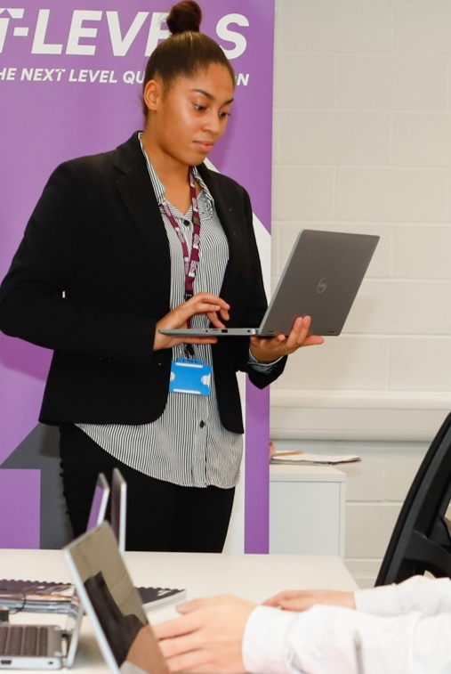

Slide 19
What are T-Levels?

Slide 20
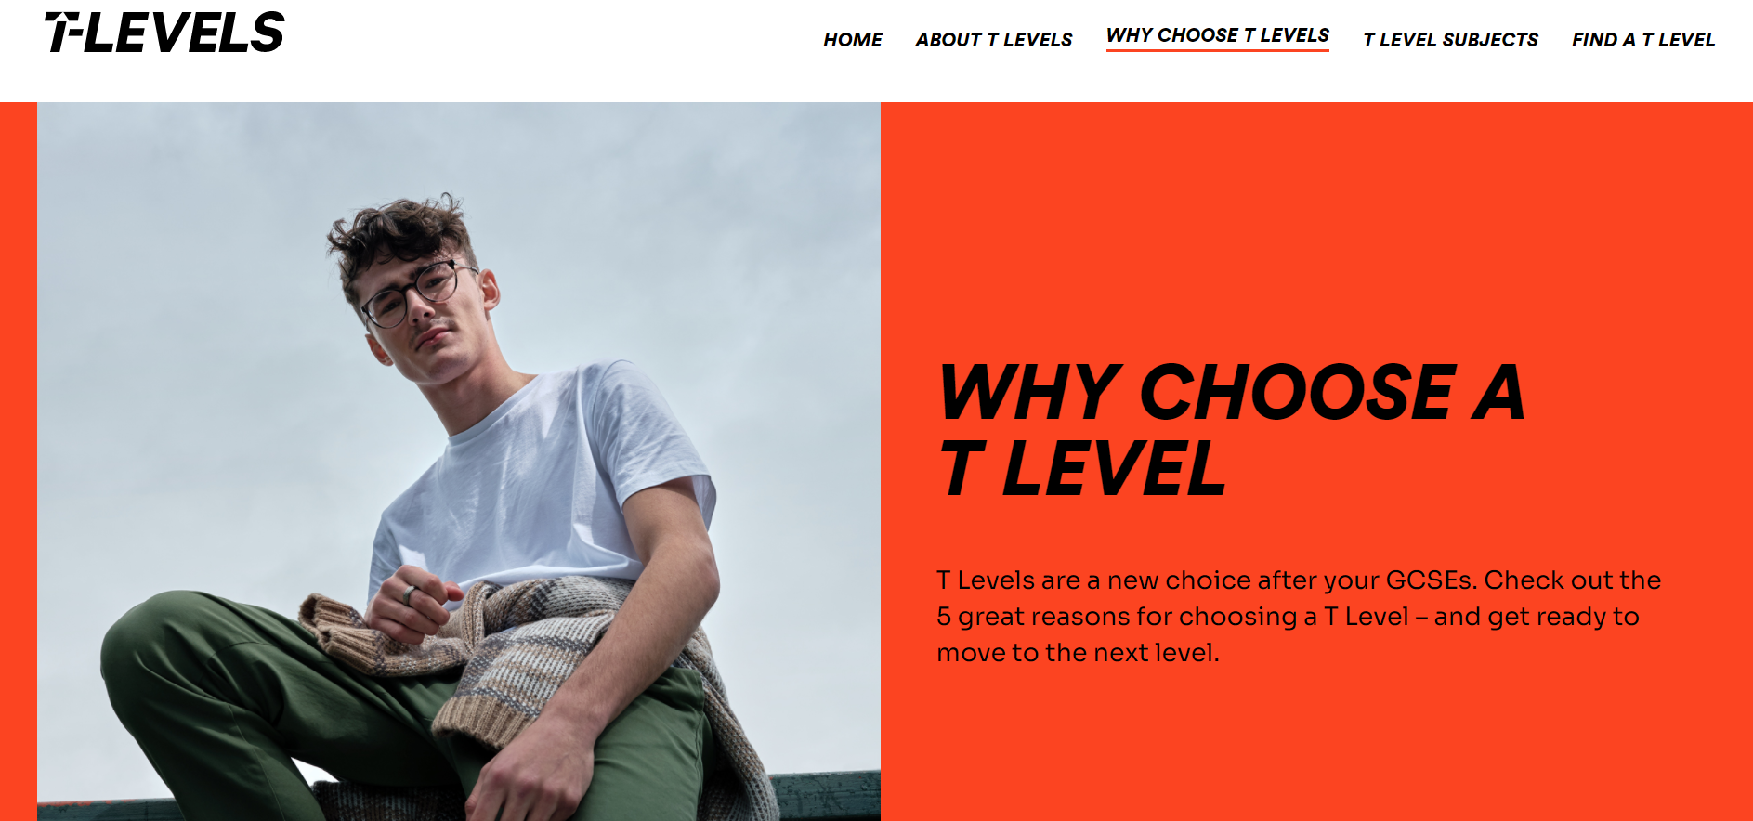
What are T-Levels?

Slide 21
OUR SIXTH FORM T LEVEL OFFER
BUSINESS
DIGITAL
HEALTH
SCIENCE
Business and Management Administration
Exam board: City & Guilds
Entry requirements: five subjects at Grade 5 including English and Maths at Grade 4
Production, Design and Development
Exam board: Pearson
Entry requirements: five subjects at Grade 5 including English and Maths at Grade 4
Supporting Adult Nursing
Exam board: NCFE
Entry requirements: five subjects at Grade 5 including English and Maths at Grade 4
Laboratory Science
Exam board: NCFE
Five GCSEs to at least grade 5 (or equivalent) including Science
(Combined or Triple). You must also have at least a grade 4 in Maths, English GCSE.

Slide 22
Consider a T Level if…
You want to pursue SKILLED EMPLOYMENT, an APPRENTICESHIP or HIGHER EDUCATION
You are excited about the INDUSTRY PLACEMENT for 45 days
You don’t just want to learn the theory, but APPLY it
You would benefit from MODULAR ASSESSMENT
You want a mix of exams and projects
You want to develop your skills whilst you learn on the job
You want to be ahead of your peers and stand out from the crowd to employers
You enjoy academic study but want to also gain practical work experience

Slide 23
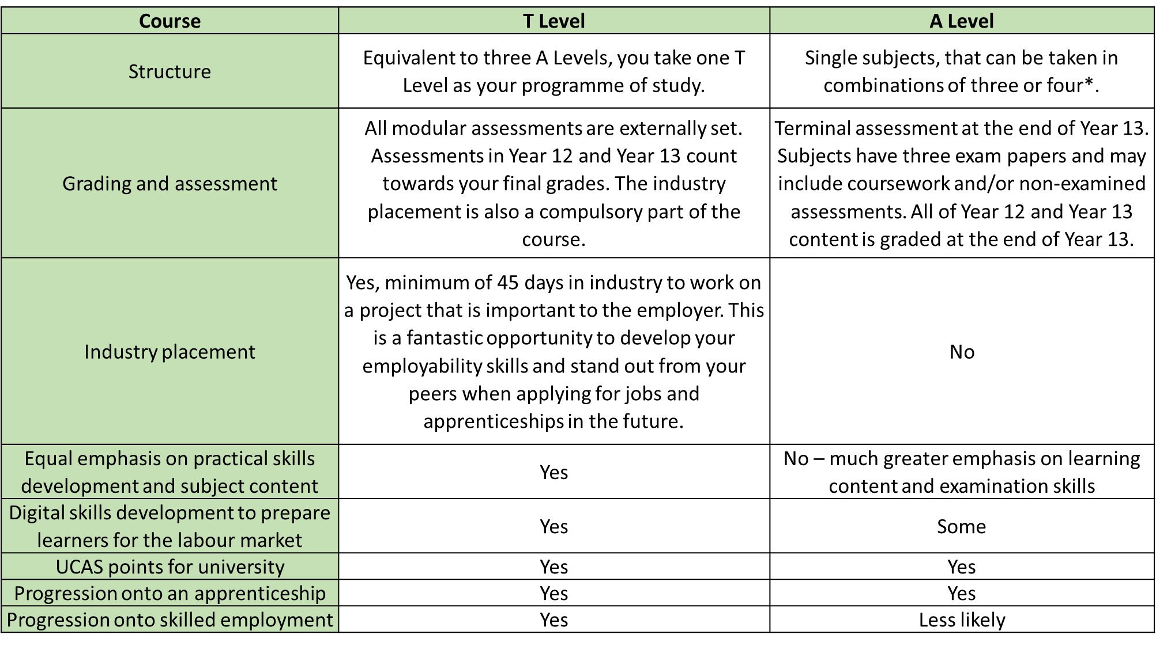
Key Differences between T Level and A Level

Slide 24
UCAS Tariff Comparison
UCAS | T Level | A Level
168 | Distinction* | AAA*
144 | Distinction | AAA
120 | Merit | BBB
96 | Pass (if at least a C was attained at Year 12) | CCC
72 | Pass (if at least a D or E was attained at Y12) | DDD

Slide 25
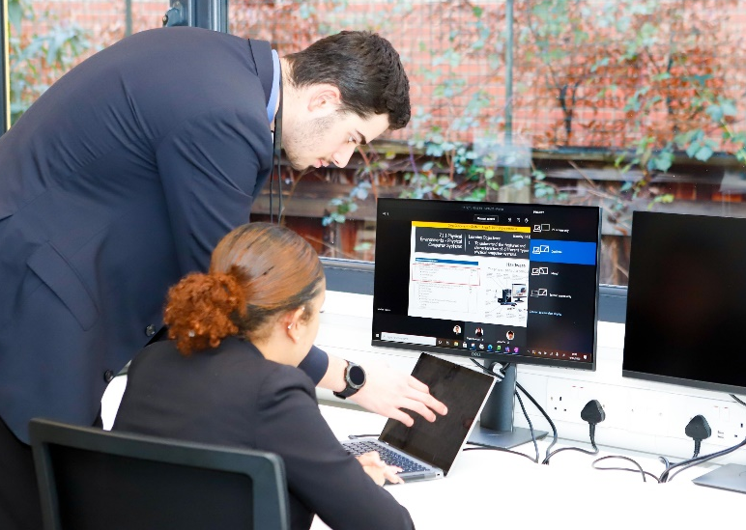
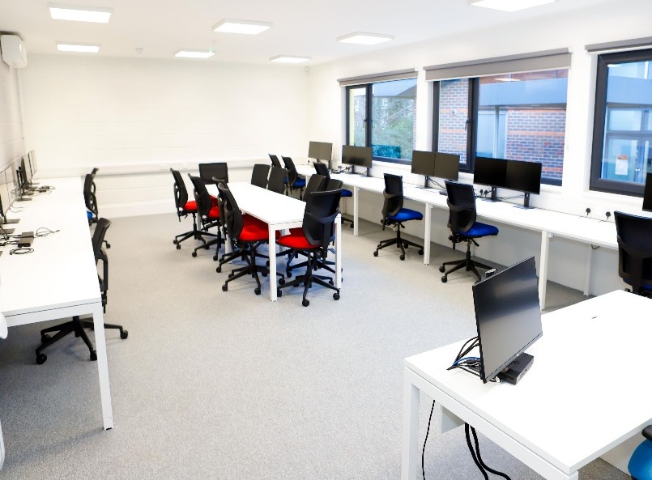
Facilities
All T Level students enjoy exclusive access to brand new purpose built facilities: the Katherine Johnson Centre and St. Annes Centre

Slide 26
Mr Breese
Head of T-Level Faculty and Laboratory Science
Matthew.breese@ursulinehigh.merton.sch.uk
Ms Bhayat
Head of T-Level (Digital Production, Design & Development)
Halima.Bhayat@ursulinehigh.merton.sch.uk
Mr Gibson
Head of T-Level (Business)
Jeremy.Gibson@ursulinehigh.merton.sch.uk
Ms Taylor
Head of T-Level (Health)
Gerladine.Taylor@ursulinehigh.merton.sch.uk

Slide 27
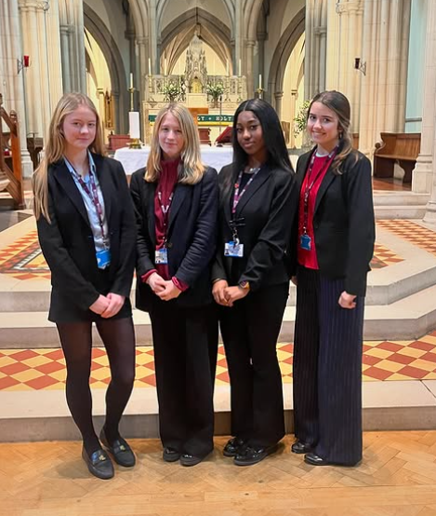
Gabriella
Joint Head Girl

Slide 28
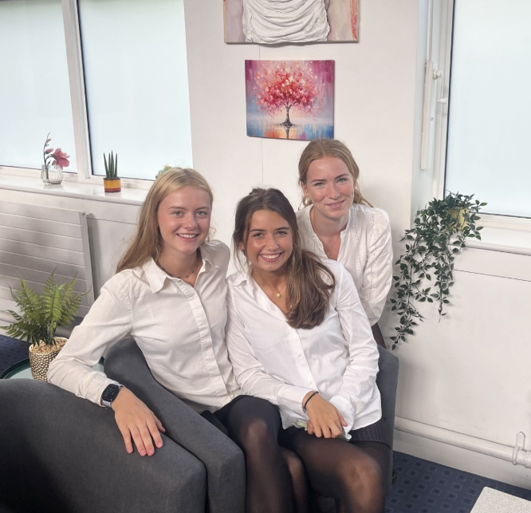
My Experience as a Student in the Ursuline Sixth Form

Slide 29
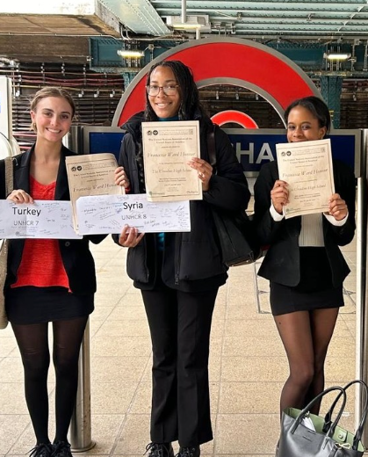
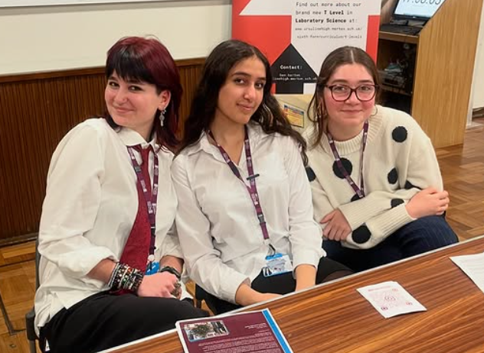
What’s it like being a student in the Ursuline 6th Form?
A loyal and supportive community
Independence and autonomy
Academic excellence
A place where you feel you belong
Fun, friendships, and memories

Slide 30
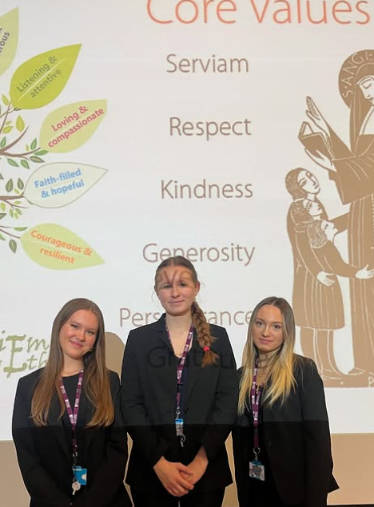
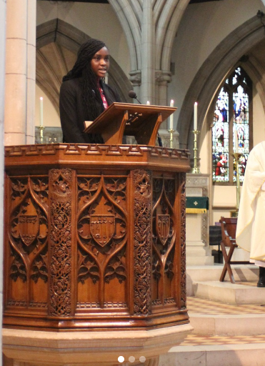
Values of our sixth form
Saint Angela Merici: “Do what you have to do with love and charity, then let God take over.”
Respect for all, regardless of age, race, color, creed, or gender.
Promote social justice, equality, and the celebration of differences.
Build a community founded on kindness and perseverance.
Foster relationships based on trust, respect, and deep understanding.
As Ursuline Sixth Form students, we strive to embody these values in our daily lives.

Slide 31
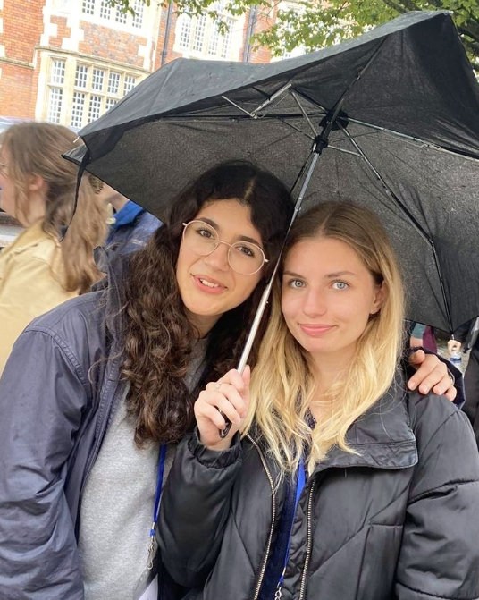
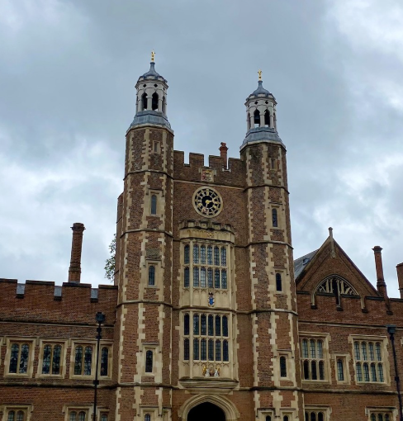
Scholarly Support Programmes - Oxbridge Programme
Support for Higher Education Applications
Dedicated staff (Ms Harrison) for course selection & research
University trips & guest speakers for informed decision-making
Super-curricular activities to deepen subject knowledge
Entrance exam support (MAT, BMAT, TSA, CAAT, SAT, PAT, STEP)
Application preparation, including admission tests & interviews
Mock interviews with professionals in your field
Specialised pre-assessment preparation (e.g., classes at King’s College)

Slide 32
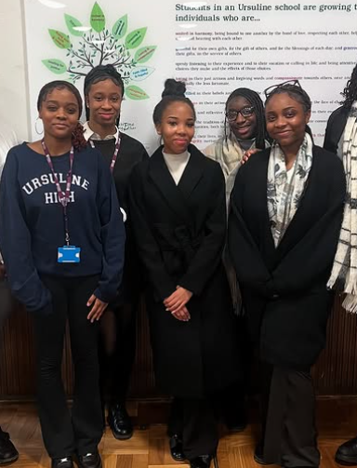
PSHE Programme
Weekly PSHE Sessions
Each week, we engage in PSHE sessions with our tutors, covering age-appropriate topics that prepare us for life beyond Sixth Form.
Our discussions centre around three key themes:
Health and Wellbeing
Sex and Relationships
Living in the Wider World
We explore topics relevant to our own experiences, ensuring meaningful discussions. Additionally, guest speakers, including our alumnae like Grace (see picture), enrich our learning with real-world insights.

Slide 33
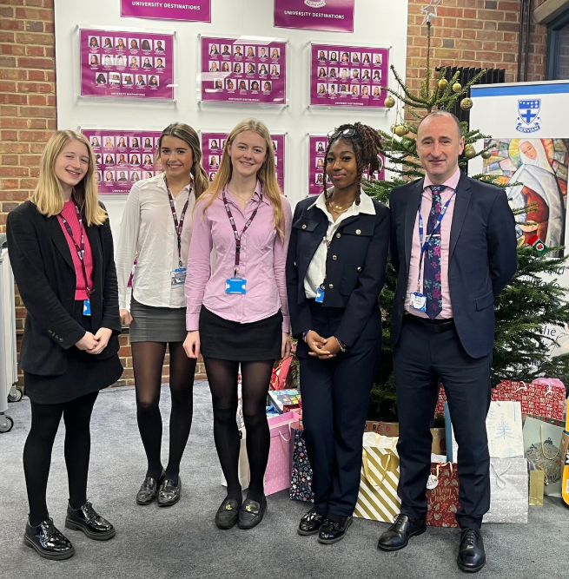
Sarena
Joint Head Girl

Slide 34
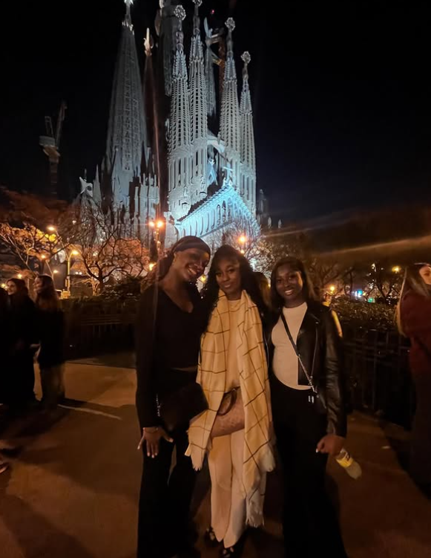
My Experience as a Student in the Ursuline Sixth Form

Slide 35
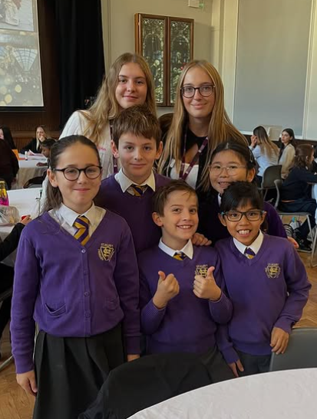
Enrichment
How it Works: Every student participates in at least one enrichment activity, scheduled within the school day during the autumn and spring terms.
Benefits:
Develop skills, experience, and opportunities
Strengthen CVs and UCAS applications
Maintain balance between academics and personal growth
Choosing an Activity:
Wide range of options to suit interests and goals
20 options across four key areas: Service, Sport & Music, Business & Leadership, and Academic Enrichment

Slide 36
Enrichment
SERVICE
Working Primary Schools: Sacred Heart Primary School, St John Fisher, St Teresa’s, or Ursuline Prep
Imagineering with KCS and a local primary
Working in Perseid- a school for children with autism
Working in a day centre for the homeless
Helping in a local food bank
SPORT
Join the football or netball teams
Help with running various sports clubs for younger years
Duke of Edinburgh Programme
MUSIC
Join the Sixth Form Choir with our Music teacher Mr Ching
BUSINESS AND LEADERSHIP
Covent Garden Business Challenge- work with primary school students to create a business idea that can be sold at Covent Garden Apple Market
Guardian Young Reporters Scheme- contribute monthly to the Guardian online paper
Conference planning and leadership

Slide 37
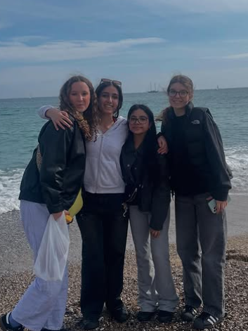
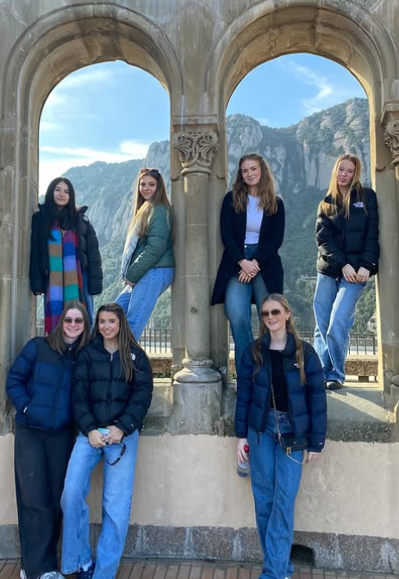
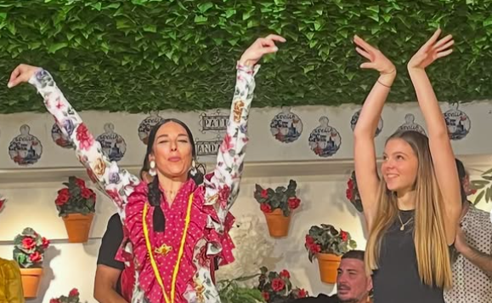
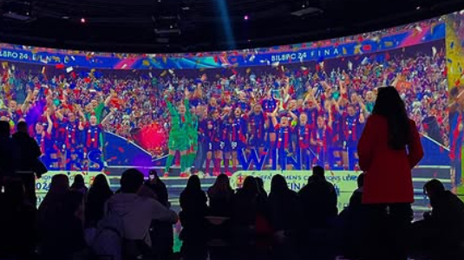
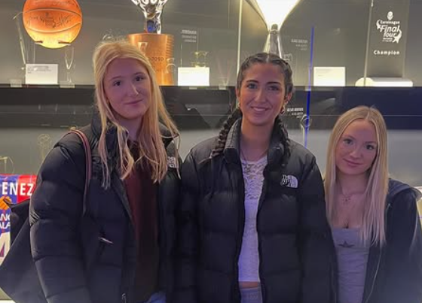
School Trips - including a foreign trip for Year 12 students

Slide 38
Sixth Form Careers & University Support
Dedicated KS5 Careers Advisor providing personalised guidance
Guest speakers from universities offering insights and advice
Exposure to university life, including student finance and campus experiences
Comprehensive university application support
Apprenticeship programme presentations for alternative career pathways
Detailed information on universities and course options
Personal statement guidance to strengthen applications
Work shadowing support to gain real-world experience
University trips

Slide 39
Thank you!
For further information, please contact:
Didier Adam
Deputy Headteacher and Head of Sixth Form
Didier.adam@ursulinehigh.merton.sch.uk
Brendan Ryan
Assistant Headteacher for Sixth Form
Brendan.ryan@ursulinehigh.merton.sch.uk
Mr Breese
Head of T Levels
Matthew.breese@ursulinehigh.merton.sch.uk

