Slide 1
URSULINE HIGH SCHOOL
Year 7
Pastoral Workshop

Slide 2
Managing friendships & social media
Aims:
To discuss friendship issues arising and best practice solutions.
To discuss the safe use of social media amongst young people.

Slide 3
Friendship Quiz
More than half of teenagers have made friends online.
True - and nearly three-in-ten teens (29%) saying they have made more than five friends this way
Less than 50% of all teenagers reported that they encountered ‘drama’ amongst friends on social media.
Wrong - 68% of social-media-using teens say they have experienced drama among friends
About half the teenagers said they fought with a friend because of what happened online.
False – only 26% of teens have experienced this type of digitally facilitated conflict but teen girls (32%) are more likely than their male counterparts (20%) to say they have had this type of conflict
https://www.pewresearch.org

Slide 4
Friendships
Points for discussion:
Why are friendships important?
To what extent has the frienship circle changed since primary school?
Were these changes easy or challenging? Have the caused problems or arguments?
How does your child deal with friendship issues?
To what extent should parents ‚manage‘ friendships?
Do you always know who your child is with and where?
The best friend?!

Slide 5
Social Media
Points for discussion:
What counts as social media?
Which social media platforms does your daughter have access to?
To what extent should parents ‘manage’ their child’s social media content?
Who is your daughter in contact with via social media?
What is/should social media be used for?

Slide 6
Scenarios
Go to a table in small groups
Read the scenario
Add your thoughts to the page
Rotate round each group when asked to
Keep adding if your response is not represented
Lets discuss

Slide 7
Lets discuss
My friends from Primary School have made new friends and are ignoring me. I feel left out.
You receive the phone call from the Head of Year to inform you that your daughter has been searching about
methods of self-harm on her tablet.
Your daughter has come home upset to tell you that a friendship group have told her that her profile picture on her
Social media is ugly.
It’s summer and your daughter wants to hang out at the park on Friday.

Slide 8
Common Social Media Platforms

Slide 9
What are these?

Slide 10
What are these?
GNOC
Getting naked on camera
IPN
I'm posting naked
CBB
Cant be bothered-
ASLP
Age, sex ,location, please-
182
I hate you
WDYM
What do you mean
LMIRL
Lets meet in real life
CICYH
Can I copy your homework-
TAW
Teacher aware
PIN
Parent in room

Slide 11
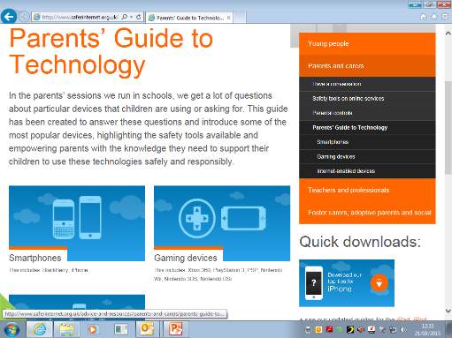
Where Can I Get Practical Advice?
www.childnet.com
www.saferinternet.org.uk
https://www.tigermobiles.com/2015/05/how-to-protect-your-children-on-their-smartphone/
https://www.internetmatters.org/
www.commonsensemedia.org

Slide 12
Tips to make new friends
Ask someone a question that cannot be answered with yes or no
Find someone with a similar hobby
Try a club in school out outside school
Be open-minded about people
Listen to other people and respond to them
Smile, wave and think about body language
Try to volunteer
Give a compliment
Be patient

Slide 13
A few Dos and Don’ts just for parents:
Do listen and communicate with your teen
Children don’t confide in their parents as much as they get older, so when they do feel like talking, really make an effort to be available and listen.
Don’t look squeamish
You (and your teen) might feel awkward talking about friendships/relationships, but do your best to look comfortable during any talks. If you look too worried or negative they will be less likely to come to you if they want to talk.
“I have no issues with my parents, we get on really well and I love them”

